Slide 1

Image Scraping & Classification
Classifying the Image

Slide 2
Contents
Problem Statement
Preprocessing
Methodology
Modelling
Conclusion

Slide 3
Problem Statement
Images are one of the major sources of data in the field of data science and AI. This field is making appropriate use of information that can be gathered through images by examining its features and details.
The objective is to build a deep learning-based Image Classification model on images that will be scraped from e-commerce portal. This task is divided into two phases: Data Collection and Mode Building

Slide 4
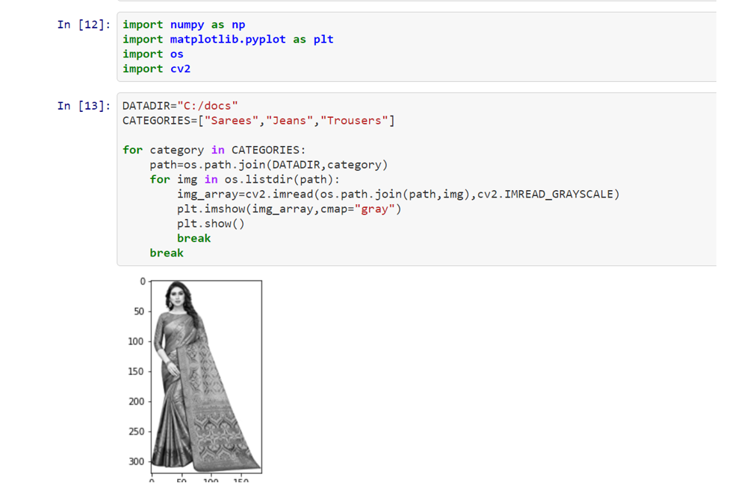
Exploratory data analysis
LOADING THE DATA

Slide 5
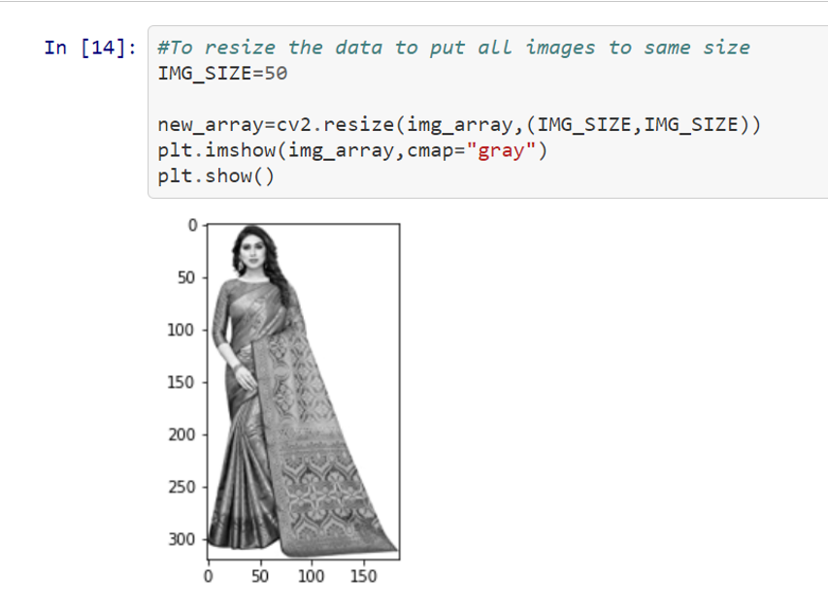
DATA PREPROCESSING
i) To RESIZE IMAGES

Slide 6
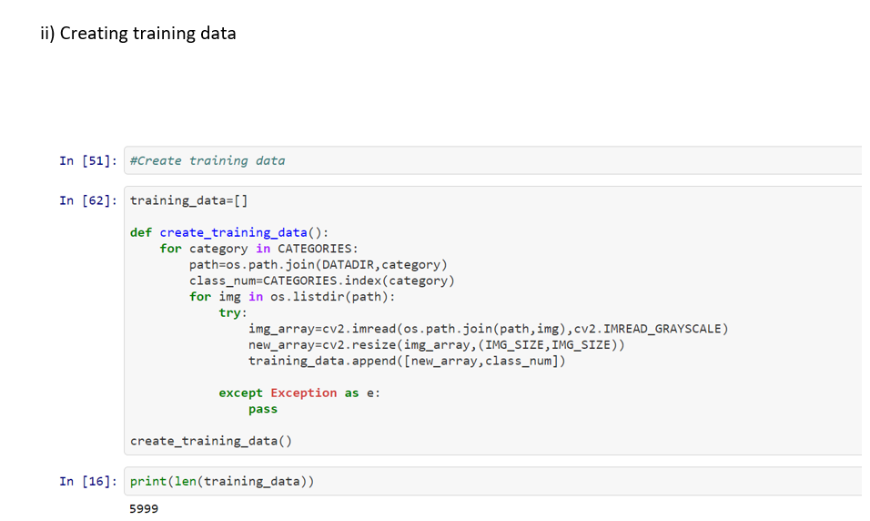
iI) CREATE TRAINING DATA

Slide 7

iII) To check if the dataset is balanced

Slide 8
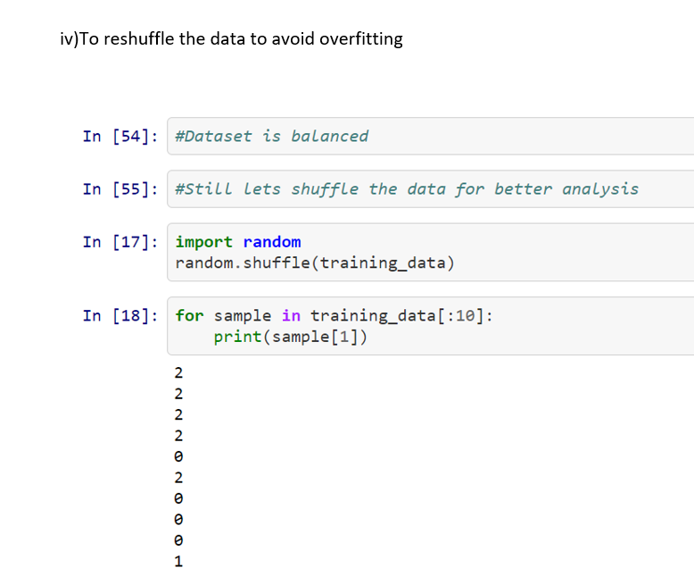
iV)To RESHUFFLE THE DATA TO AVOID UNDERFITTING

Slide 9
Model Building
Model As specified below have been run :
CNN CONVOLUTION NETWORK

Slide 10
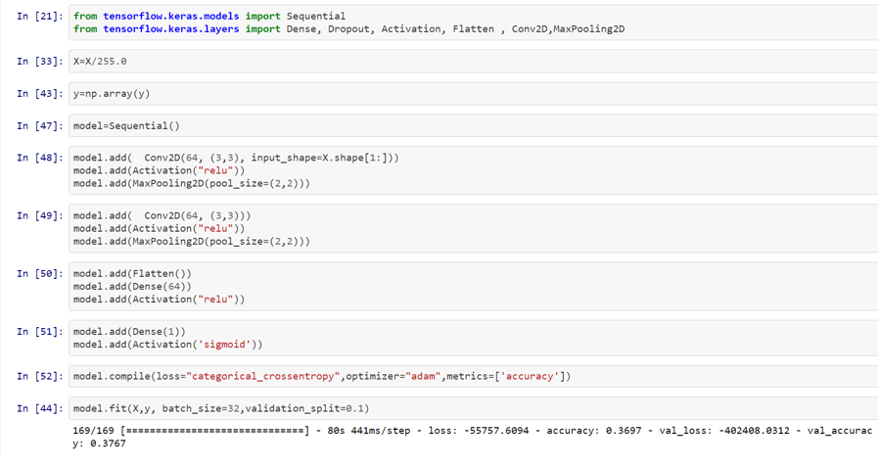

Slide 11
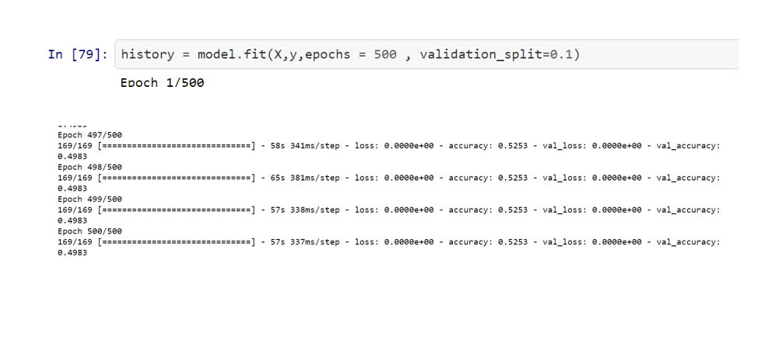

Slide 12
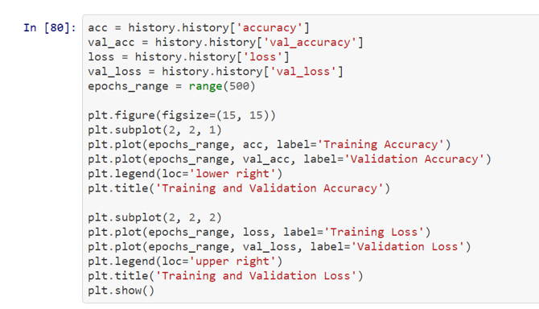
ACCURACY

Slide 13
scope for future
The future of image processing will involve scanning the heavens for other intelligent life out in space. Also new intelligent, digital species created entirely by research scientists in various nations of the world will include advances in image processing applications. Due to advances in image processing and related technologies there will be millions and millions of robots in the world in a few decades time, transforming the way the world is managed. Advances in image processing and artificial intelligence6 will involve spoken commands, anticipating the information requirements of governments, translating languages, recognizing and tracking people and things, diagnosing medical conditions, performing surgery, reprogramming defects in human DNA, and automatic driving all forms of transport. With increasing power and sophistication of modern computing, the concept of computation can go beyond the present limits and in future, image processing technology will advance and the visual system of man can be replicated. The future trend in remote sensing will be towards improved sensors that record the same scene in many spectral channels. Graphics data is becoming increasingly important in image processing app1ications. The future image processing applications of satellite based imaging ranges from planetary exploration to surveillance applications.
Using large scale homogeneous cellular arrays of simple circuits to perform image processing tasks and to demonstrate pattern-forming phenomena is an emerging topic. The cellular neural network is an implementable alternative to fully connected neural networks and has evolved into a paradigm for future imaging techniques. The usefulness of this technique has applications in the areas of silicon retina, pattern formation, etc

